Slide 1
Capstone Project
Krystal Si Huang
July 24, 2020

Slide 2
Part 1: introduction
According to a report prepared by Canadian Bureau for International Education (CBIE, 2018), as a result of varied and evolving push and pull factors, international students are choosing Canada as their study destination in unprecedented numbers. In 2017, for example, there were 494,525 international students in Canada at all levels of study, which represents a 17% increase over the previous year (CBIE, 2018).

Slide 3
Part 1: introduction
As the top university of the country, the University of Toronto (UofT) has attracted many international students. It is estimated that 26% of the student population at the University of Toronto is comprised of international students (Maclean’s, 2016). For international students, the prospect of flying half-way round the world to study in Canada can be daunting, and adjusting to new life here is indeed a challenge. However, incoming international students don't have to be scary or stressful. After all, what makes studying abroad so special is that the process is always exciting and rewarding. New sights, new food, new languages and a different climate will stimulate your senses!
This project will mainly explore city of Toronto (i.e., hotels, restaurants, attractions) to help international students navigate their life as well as take the stress out of studying here.

Slide 4
Part 2: Methodology
This capstone project will be using Foursquare to explore the city of Toronto, just as what we learned in this module. Searching for a specific venue category using Foursquare API will be the primary methodology. We'll start by locating some hotels and restaurants near UofT campus and use the visualization library, Folium, to visualize the results. We will then move on to explore some main attractions in the city of Toronto. To do this, Foursquare API is employed.

Slide 5
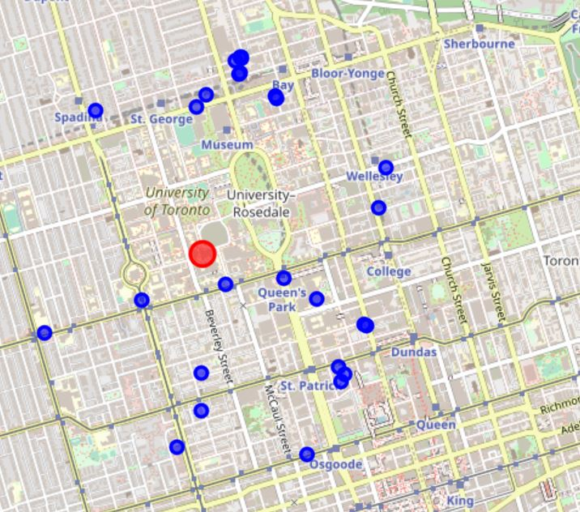
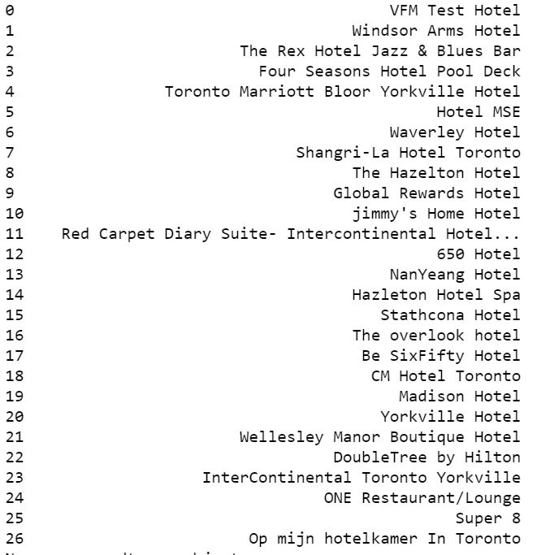
Part 3: analysis and output
Hotels near the UofT campus

Slide 6
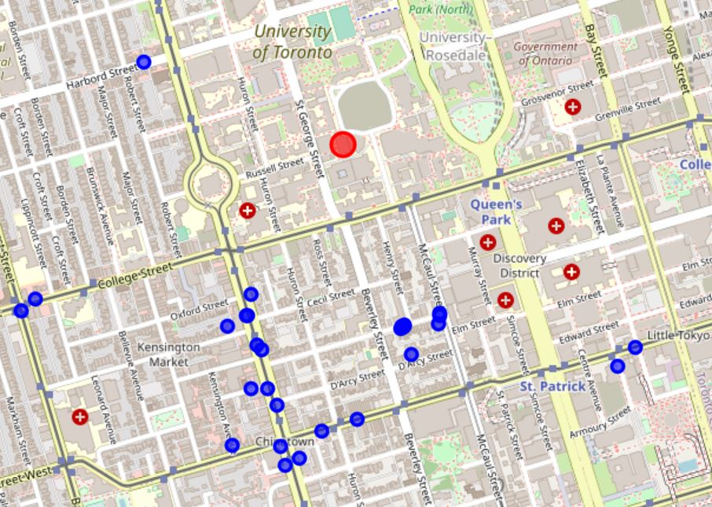
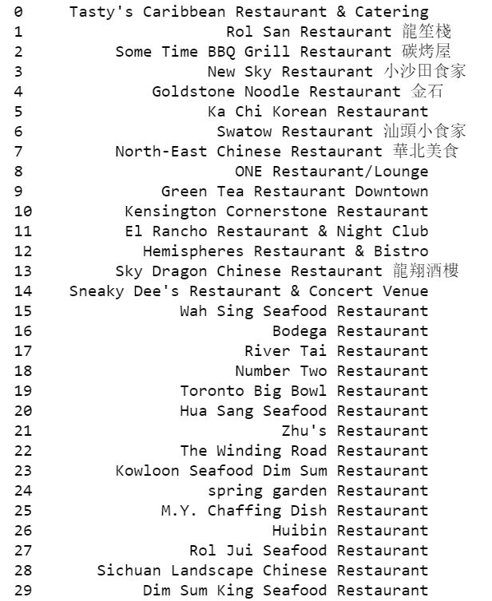
Part 3: analysis and output
Restaurants near the UofT campus

Slide 7
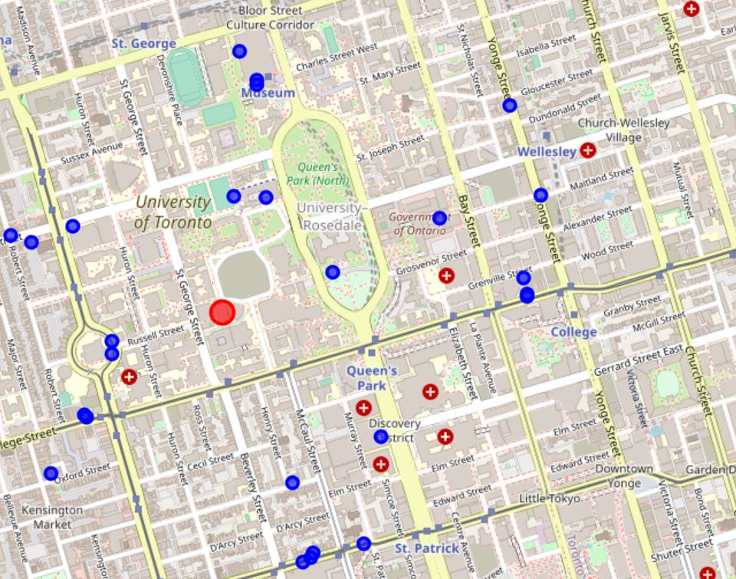
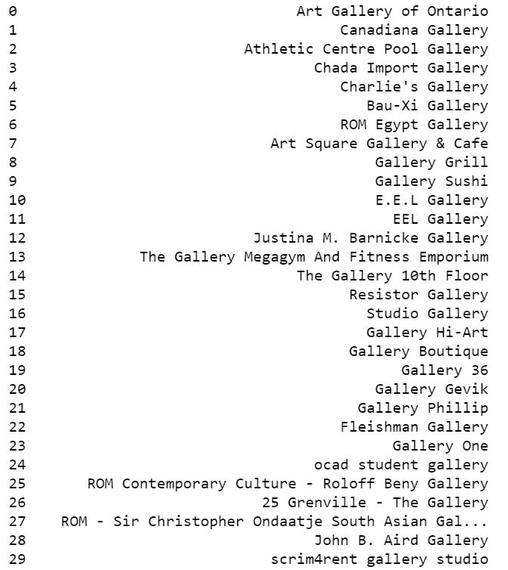
Part 3: analysis and output
Art galleries nearby

Slide 8
Part 4: Results, Conclusion and Discussion
By using Foursquare location data, we examined the hotels, restaurants, parks, and galleries near the UofT campus. In particualr, we've found that within 1,000 meters from campus, there are 26 hotels and 29 restaurants. In addition, 29 art galleries are also being displyed using Foursquare location data. It is worth noting that among 29 restaurants, we see that a lot of them are categorized as Chinese restaurants. This is not surprising. It is reported that 30% of international students pursuing studies in Canada come from China (CBIE, 2018); thus, opening Chinese restaurants is an effective way to accommodate those students.

Slide 9
Reference
1. “International Students in Canada.” Canadian Bureau for International Education, Aug. 2018, cbie.ca/wp-content/uploads/2018/09/International-Students-in-Canada-ENG.pdf.
2. Dywer, Mary. “These Canadian Universities Have the Most International Students.” Https://Www.Macleans.ca/Education/Which-Canadian-Universities-Have-the-Most-International-Students/, Nov. 2017, www.macleans.ca/education/which-canadian-universities-have-the-most-international-students.

